Slide 1

Mafs
3 x 3 Matrix, About Determinant & Inverse

Slide 2
So, this is us
Davis Maulana Hermanto / 06
Dicha Zelianivan Arkana / 08
Muhammad Baihaqi Aulia Asy’ari / 18
Yanuar Thaif Chalil Candra / 28

Slide 3
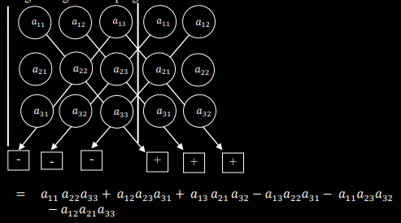
Determinant
Here is the concept of how determinant works
Copy 1st and 2nd column next to the 3rd column
Draw a diagonal line ass such that the line cross 3 elements in neighboring column
Do it again to all element in the 1st row
Add up the multiplication of the line that goes to bottom right
Subtract the multiplication of the line that goes to bottom left
This method is called Sarrus

Slide 4
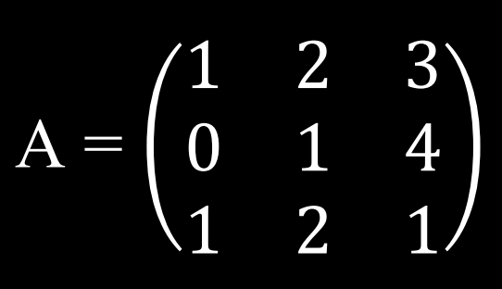
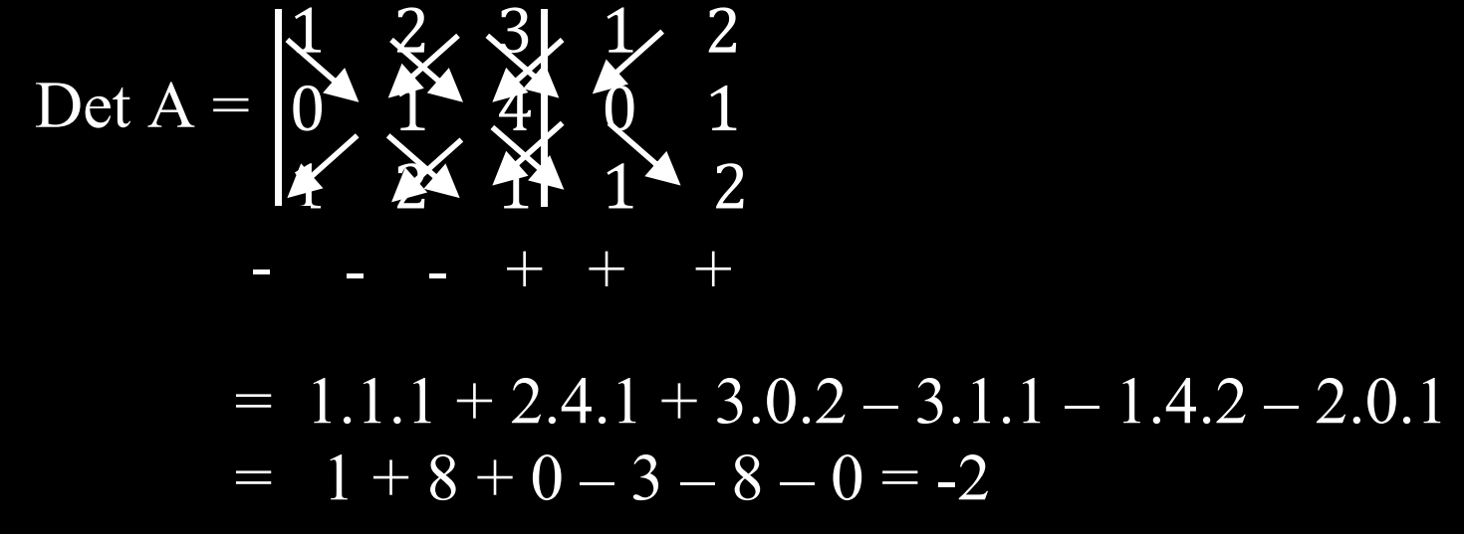
Determinant
(Example)

Slide 5
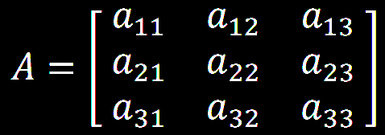
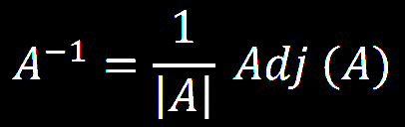
Inverse
So, in order to create an inverse, we need 2 component
Determinant of the matrix
The adjugate of the matrix

Slide 6
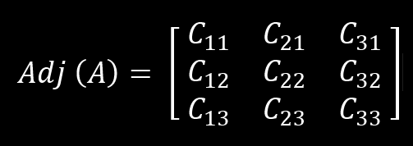

Inverse
In order to find adjoint of the matrix we need to
Transpose the matrix without changing the row and column number
Select an element row and column number
Remove every element with the same row and column index. There should be 4 leftover element.
Use the determinant of the left over element as the element of the selected element.
Repeat for every element
Alternate positive and negative sign for each element ass such that the side to side neighboring element is not the same sign and diagonally neighboring element is the same sign. Starting with the element a11 with positive sign

Slide 7
Inverse
In order to find adjoint of the matrix we need to
Transpose the matrix without changing the row and column number
Select an element row and column number
Remove every element with the same row and column index. There should be 4 leftover element.
Use the determinant of the left over element as the element of the selected element.
Repeat for every element
Alternate positive and negative sign for each element ass such that the side to side neighboring element is not the same sign and diagonally neighboring element is the same sign. Starting with the element a11 with positive sign

Slide 8
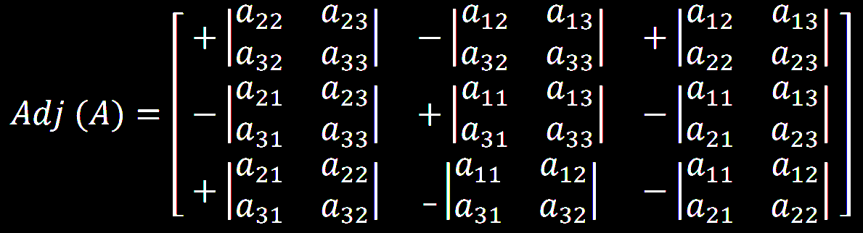
Inverse
In order to find adjoint of the matrix we need to
Transpose the matrix without changing the row and column number
Select an element row and column number
Remove every element with the same row and column index. There should be 4 leftover element.
Use the determinant of the left over element as the element of the selected element.
Repeat for every element
Alternate positive and negative sign for each element ass such that the side to side neighboring element is not the same sign and diagonally neighboring element is the same sign. Starting with the element a11 with positive sign
I

Slide 9
Inverse
Or to put it simply
Transpose the matrix
Find the minor for every element
Find the cofactor for every element
I

Slide 10
Inverse
Next, we need combine all components that we have
Divide the Adjoint of matrix A with the Determinant of the matrix

Slide 11
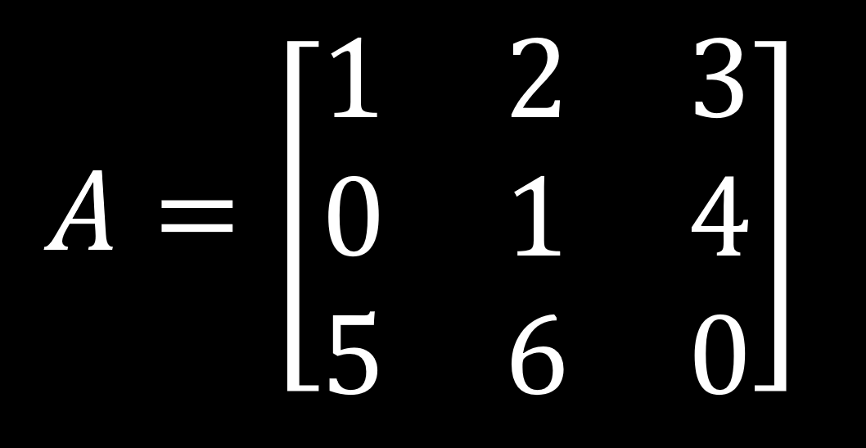
Inverse
(Example)
Let's Try to determine the Inverse of this Matrix

Slide 12
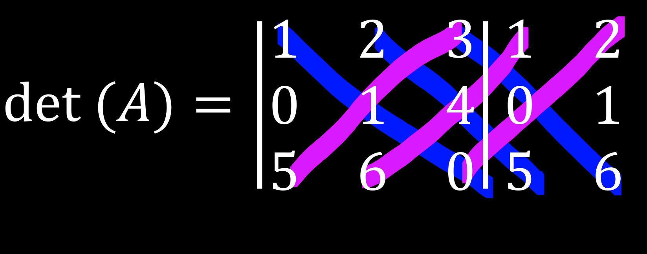
Inverse
(Example)
First let's find the determinant of this matrix
Copy the first and second column next to the Matrix
Then Cross the Element

Slide 13
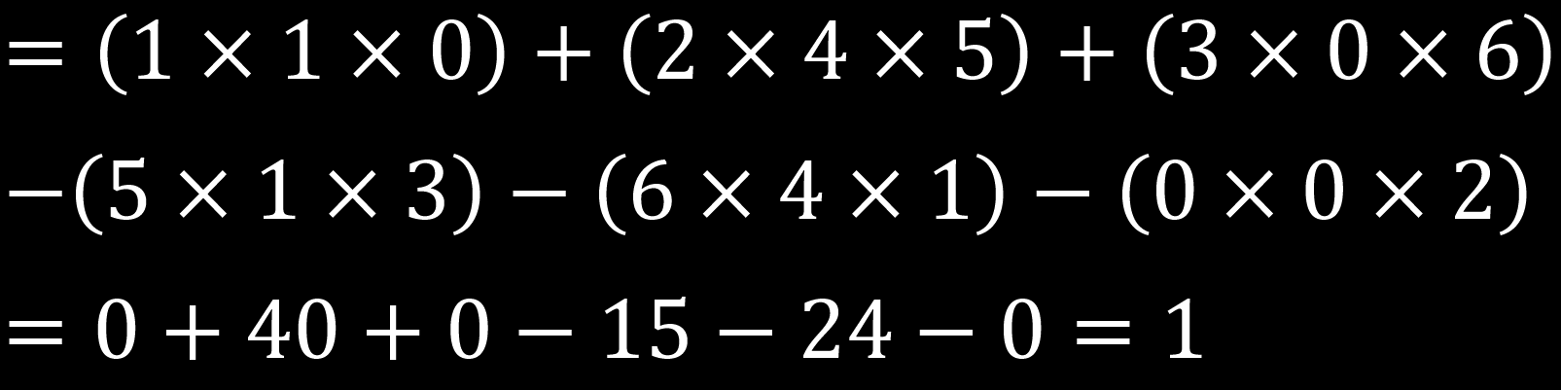
Inverse
(Example)
Next, multiply every line and add and subtract

Slide 14
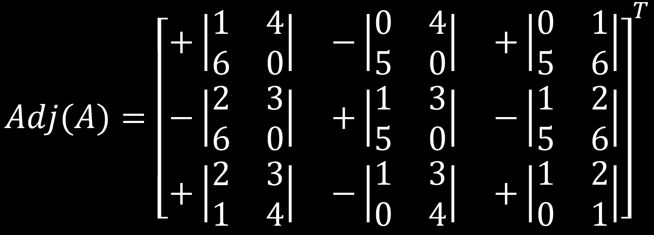
Inverse
(Example)
Next, Let's try to find adjoint of matrix A
Calculate the Minor of every element in the matrix
And then put the cofactor for each element

Slide 15
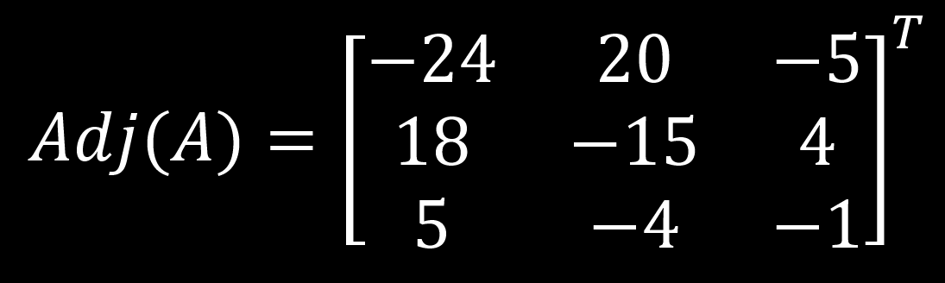
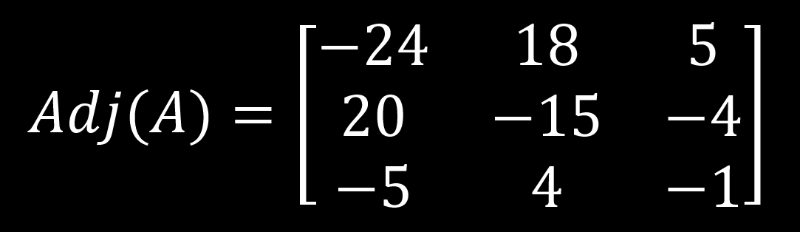
Inverse
(Example)
Next, Calculate the determinant for each element
And then transpose the matrix

Slide 16
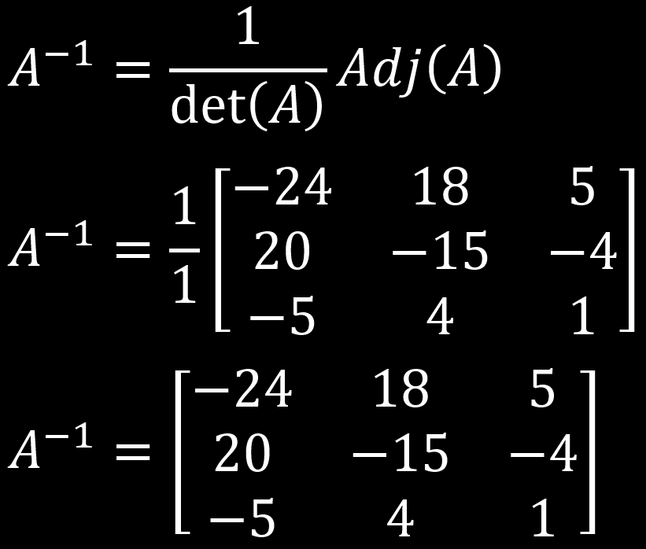
Inverse
(Example)
Next, Let's combine it all
Insert the result of the Determinant and Adjoint calculation
And multiply the result

Slide 17


